Slide 1
LECTURE -9(a)
Logistic Regression
Course Instructor
Engr. Naina Said

Slide 2
CSE-422: Data Analytics
Linear Regression Review
In linear regression, we fit a straight line to our data.
We can do many things with the fitted line.
Calculate R² and determine if our input variables and output variable is correlated. Large R² value represent large effect.
Calculate a p- value to determine if our coefficients are statistically significant.
Finally, make predictions with the fitted line.

Slide 3
CSE-422: Data Analytics
Logistic Regression
Logistic Regression is used for classification (Although the name might be a little misleading).
In LR, we predict whether something is true or false.
The output of LR is probability.
We can threshold the probability to get different class labels.

Slide 4
CSE-422: Data Analytics
Important Note
In linear regression, the expected values of the response variable are modeled based on combination of values taken by the predictors.
In logistic regression, Probability or Odds of the response taking a particular value is modeled based on combination of values taken by the predictors.

Slide 5
CSE-422: Data Analytics
Applications of Logistic Regression
LR is applicable if
We want to model the probabilities of a response variable as a function of some explanatory variables, e.g. "success" of admission as a function of gender.
We want to classify individuals into two categories based on explanatory variables, e.g. classify new students into "admitted" or "rejected" group depending on their gender.

Slide 6
CSE-422: Data Analytics
Classification Problems
Email Spam/Not Spam?
Online Transaction Fraudulent (Yes/No)?
Tumor (Malignant/Benign)?
𝑦 ∈ {0,1}
0 : Negative Class 1 : Positive Class
𝑦 ∈ {0,1,2,3}
Multi class classification problem

Slide 7
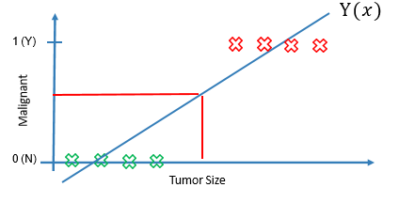
CSE-422: Data Analytics
Using Linear Regression for Classification (1)
Consider we want to build a classifier which predicts whether a patient has malignant tumor or not.
What happens when we try to fit a straight line to our data using linear regression?
Threshold classifier output y(𝑥) at 0.5
If y(x)≥ 0.5, predict 𝑦 = 1
If y(x) < 0.5, predict 𝑦 = 0

Slide 8
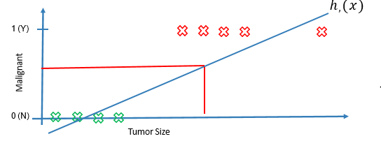
CSE-422: Data Analytics
Using Linear Regression for Classification (2)
Patient has malignant tumor
Threshold classifier output y(𝑥) at 0.5
If y(x)≥ 0.5, predict 𝑦 = 1
If y(x) < 0.5, predict 𝑦 = 0

Slide 9
CSE-422: Data Analytics
Problem with Using Linear Regression for Classification
Classification Problem
Y=1 (cancer being malignant)
Y=0 (cancer being benign)
But with linear regression, the output can be
y>1
Y<0
Even when all the training set outputs are either 0 or 1

Slide 10
CSE-422: Data Analytics
Logistic Regression Requirements
Logistic Regression Model
0 ≤ y≤ 1
Where y is the probability that an instance belongs to a particular class.
Searching for a function which
Must always be positive (since p>0)
It must be less than 1 (since p<1)

Slide 11
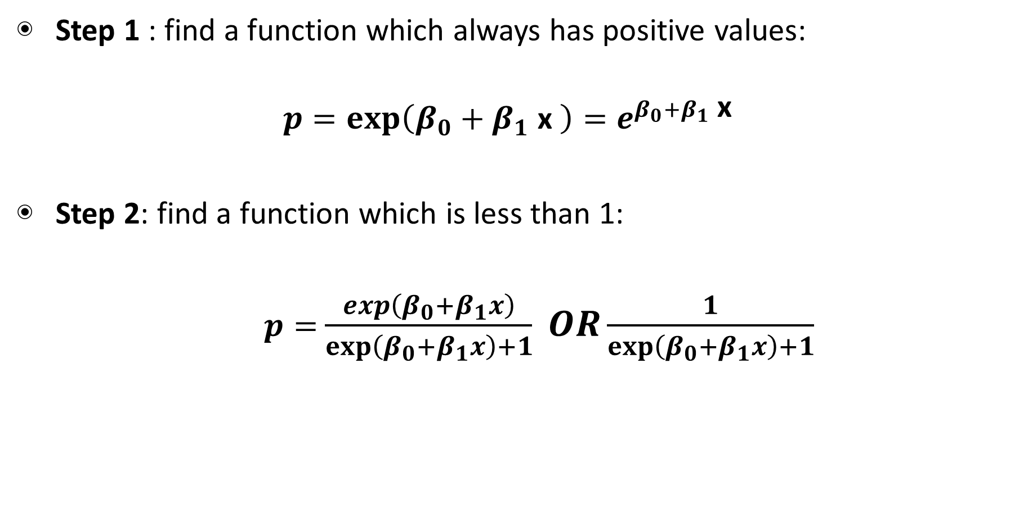
CSE-422: Data Analytics
Logistic Regression Representation
Step 1 : find a function which always has positive values:
$$p=exp\left(β_{0}+β_{1} \text{x} \right)=e^{β_{0}+β_{1} \text{x} }$$
Step 2: find a function which is less than 1:
$p=$ $\frac{\exp\left(β_{0}+β_{1}x\right)}{exp\left(β_{0}+β_{1}x\right)+1} OR\frac{1}{exp\left(β_{0}+β_{1}x\right)+1}$
This is our equation of logistic regression! Also called the sigmoid function.

Slide 12
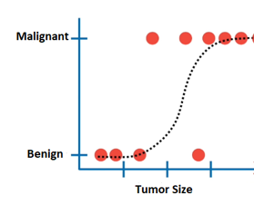
CSE-422: Data Analytics
Fitting a Sigmoid function to Data
Instead of fitting a line to the data, logistic regression fits a “S” shaped logistic function.
The curve tells you the probability that whether a tumor is malignant based on its size.

Slide 13
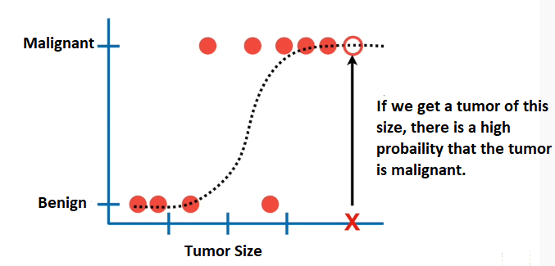
CSE-422: Data Analytics
Making Prediction with the fitted function

Slide 14
CSE-422: Data Analytics
Probability and Odds
Chance can be expressed either as a probability or as odds.
The probability that an event will occur is the fraction of times you expect to see that event in many trials. Probabilities always range between 0 and 1.
The odds are defined as the probability that the event will occur divided by the probability that the event will not occur.

Slide 15
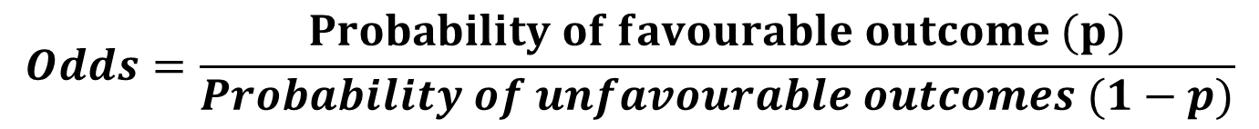
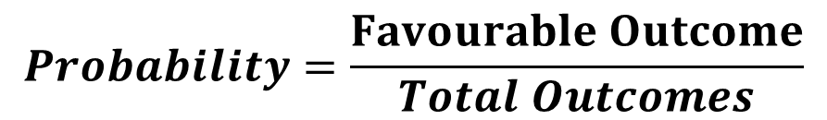
CSE-422: Data Analytics
Probability and Odds (2)
$$Probability=\frac{Favourable Outcome}{Total Outcomes}$$
The probability of getting a 3 on a dice is 1/6 = 0.167.
The odds are 1:5
If you are given probability of a event, you can find the odds by using the following formula
$$Odds=\frac{Probability of favourable outcome (p)}{Probability of unfavourable outcomes (1−p)}$$

Slide 16
CSE-422: Data Analytics
Probability and Odds (2)
Logistic Regression seeks to
Model the probability of an event occurring depending on the values of the independent variables, which can be categorical or numerical.
Estimates the probability that an event occurs for a randomly selected observations versus the probability that the event does not occur.
Classify observations by estimating the probability that an observation is in a particular category. (Such as email is spam or not spam)

Slide 17

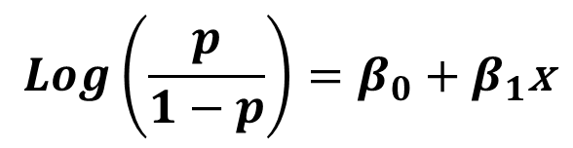
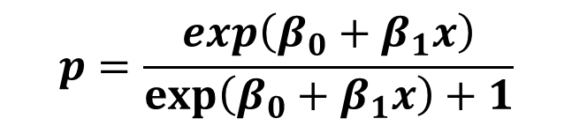
CSE-422: Data Analytics
Simplifying Logistic Regression Equation
Recall our logistic regression equation
This seems a bit complex. We want to have this in terms of linear combination of our input variables.
By doing some algebra
$$p=\frac{\exp\left(β_{0}+β_{1}x\right)}{exp\left(β_{0}+β_{1}x\right)+1}$$
$$\operatorname{Log}\left(\frac{p}{1−p}\right)=β_{0}+β_{1}\text{x}$$
$$\operatorname{Log}\left(odds\right)=β_{0}+β_{1}\text{x}$$
This is called Logit function.

Slide 18
CSE-422: Data Analytics
How to find the Coefficients?
Logistic Regression does not have the concept of residual like linear regression and so can not use the least square method to fit the curve to the data
It instead uses a concept called Maximum likelihood

Slide 19
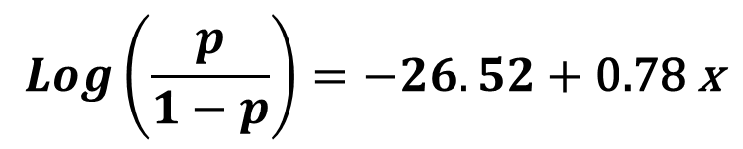
CSE-422: Data Analytics
Interpretation of Co-Efficients in LR
Consider we get a equation like this after doing logistic regression.
What does this 0.78 mean here?
Remember the interpretation is not the same as in linear regression.
Here, a one unit change in x will result in 0.78 increase in the log of ODDS holding all other variables constant.
We use this value to then calculate the probability.
$$\operatorname{Log}\left(\frac{p}{1−p}\right)=−26.52+\text{0.78} \text{x}$$

Slide 20
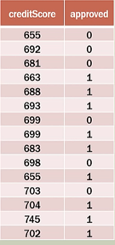
CSE-422: Data Analytics
Example
We are required to build a classifier which predicts whether a customer will be approved for debt given his credit score

Slide 21
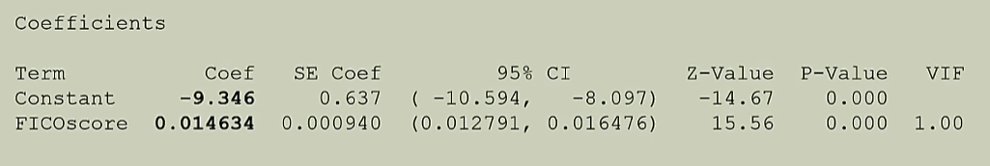
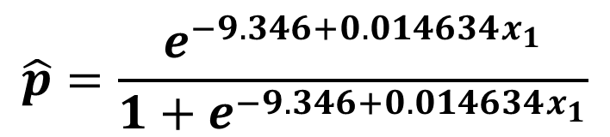
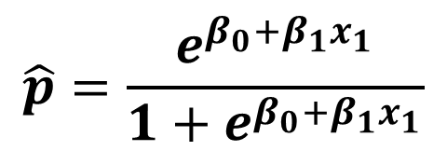
CSE-422: Data Analytics
Example- Using coefficients to Calculate Probabilities
$$\hat{p}=\frac{e^{β_{0}+β_{1}x_{1}}}{1+e^{β_{0}+β_{1}x_{1}}}$$
$$\hat{p}=\frac{e^{−9.346+0.014634x_{1}}}{1+e^{−9.346+0.014634x_{1}}}$$

Slide 22
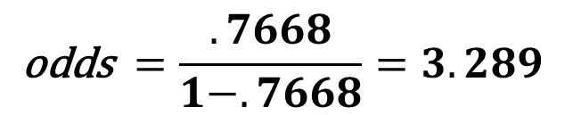
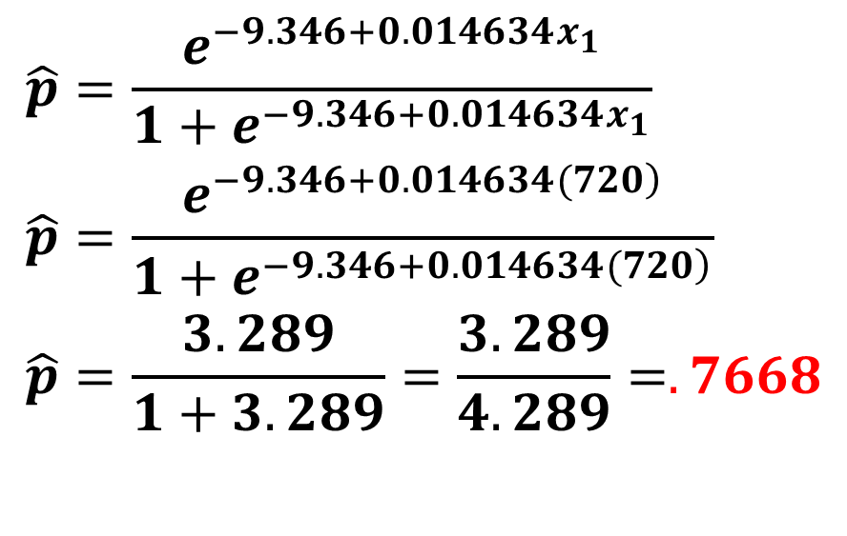
CSE-422: Data Analytics
Example- Using coefficients to Calculate Probabilities
For credit score of 720
$$\begin{aligned}&\hat{p}=\frac{e^{−9.346+0.014634x_{1}}}{1+e^{−9.346+0.014634x_{1}}} \\ &\hat{p}=\frac{e^{\left.−9.346+0.014634(720\right)}}{1+e^{\left.−9.346+0.014634(720\right)}} \\ &\hat{p}=\frac{3.289}{1+3.289}=\frac{3.289}{4.289}=.7668 \\ & \\ \end{aligned}$$
$$\text{odds} =\frac{.7668}{1−.7668}=3.289$$

Slide 23
CSE-422: Data Analytics
Multiple Logistic Regression
Just like multiple linear regression, we can also have a multiple logistic regression where the probability is decided based on multiple independent variables.
Consider that we want to find the probability of a customer subscribing to a magazine based on their age as well as gender.
Our coefficients we got from the software:
Variable | Coefficient
Constant | -26.52400
Age | 0.781053
Gender | -0.56

Slide 24
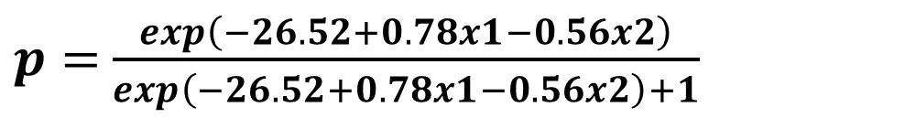
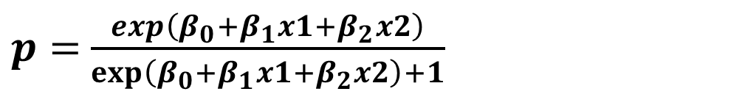
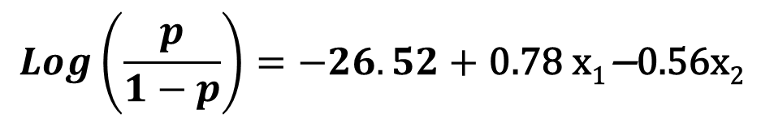
CSE-422: Data Analytics
Multiple Logistic Regression
$$\operatorname{Log}\left(\frac{p}{1−p}\right)=−26.52+\text{0.78} \text{x}\text{1}\text{−}\text{0.56}\text{x}\text{2 }$$
$p=$ $\frac{\exp\left(β_{0}+β_{1}x1+β_{2}x2\right)}{exp\left(β_{0}+β_{1}x1+β_{2}x2\right)+1}$
$p=$ $\frac{\exp\left(−26.52+0.78x1−0.56x2\right)}{\exp\left(−26.52+0.78x1−0.56x2\right)+1}$
We can now calculate probability for different values of x
Notes:
This too

